Slide 1

AIR POLLUTION
Presented By : Mathireddi Munikumar
PIN :23551A0597
Supervisor: Dr.B.Sujatha
Designation: Head of the Department,
Dept. of CSE, GIET(A)

Slide 2
CONTENTS
Introduction
Major Pollutants
Natural Sources
Impact of air pollution on Human health,
Environmental health
Control Measures
Conclusion

Slide 3
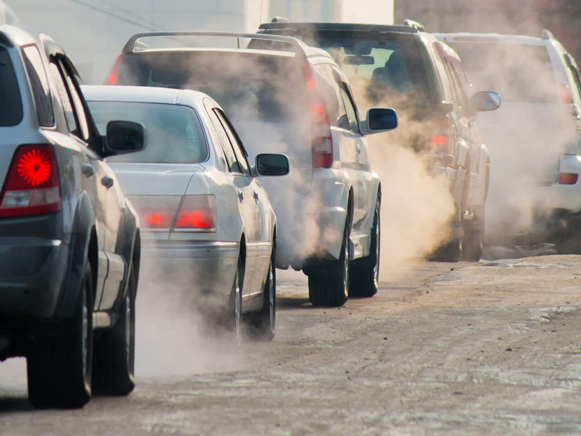
INTRODUCTION
Air pollution refers to the presence of harmful substances or
contaminants in the air that can cause adverse effects on
human health, the environment, and the climate.
These pollutants can come from various sources,
including:-
Industrial emissions (factories, powerplants etc…)
Vehicle emissions (from cars, buses etc ….)
Natural sources (dust storms, wildfires etc…)
Waste Disposal (by Burning waste, waste disposal etc…)

Slide 4
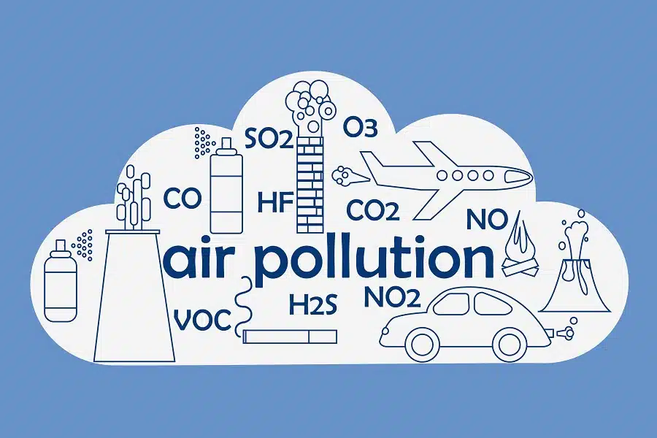
MAJOR POLLUTANTS
The major pollutants of air pollution are:
Particulate Matter (PM): Tiny particles that can cause respiratory problems
Nitrogen Oxides (NOx): Gases that contribute to smog and respiratory problems,
Sulphur Dioxide (SO2): A gas that can cause respiratory problems and acid rain.
Carbon Monoxide (CO): A gas that can cause headaches, dizziness, and nausea.
Ozone (O3): A gas that can irritate lungs and exacerbate respiratory problems.
Lead: A toxic metal that can cause neurological damage and other health problems.

Slide 5
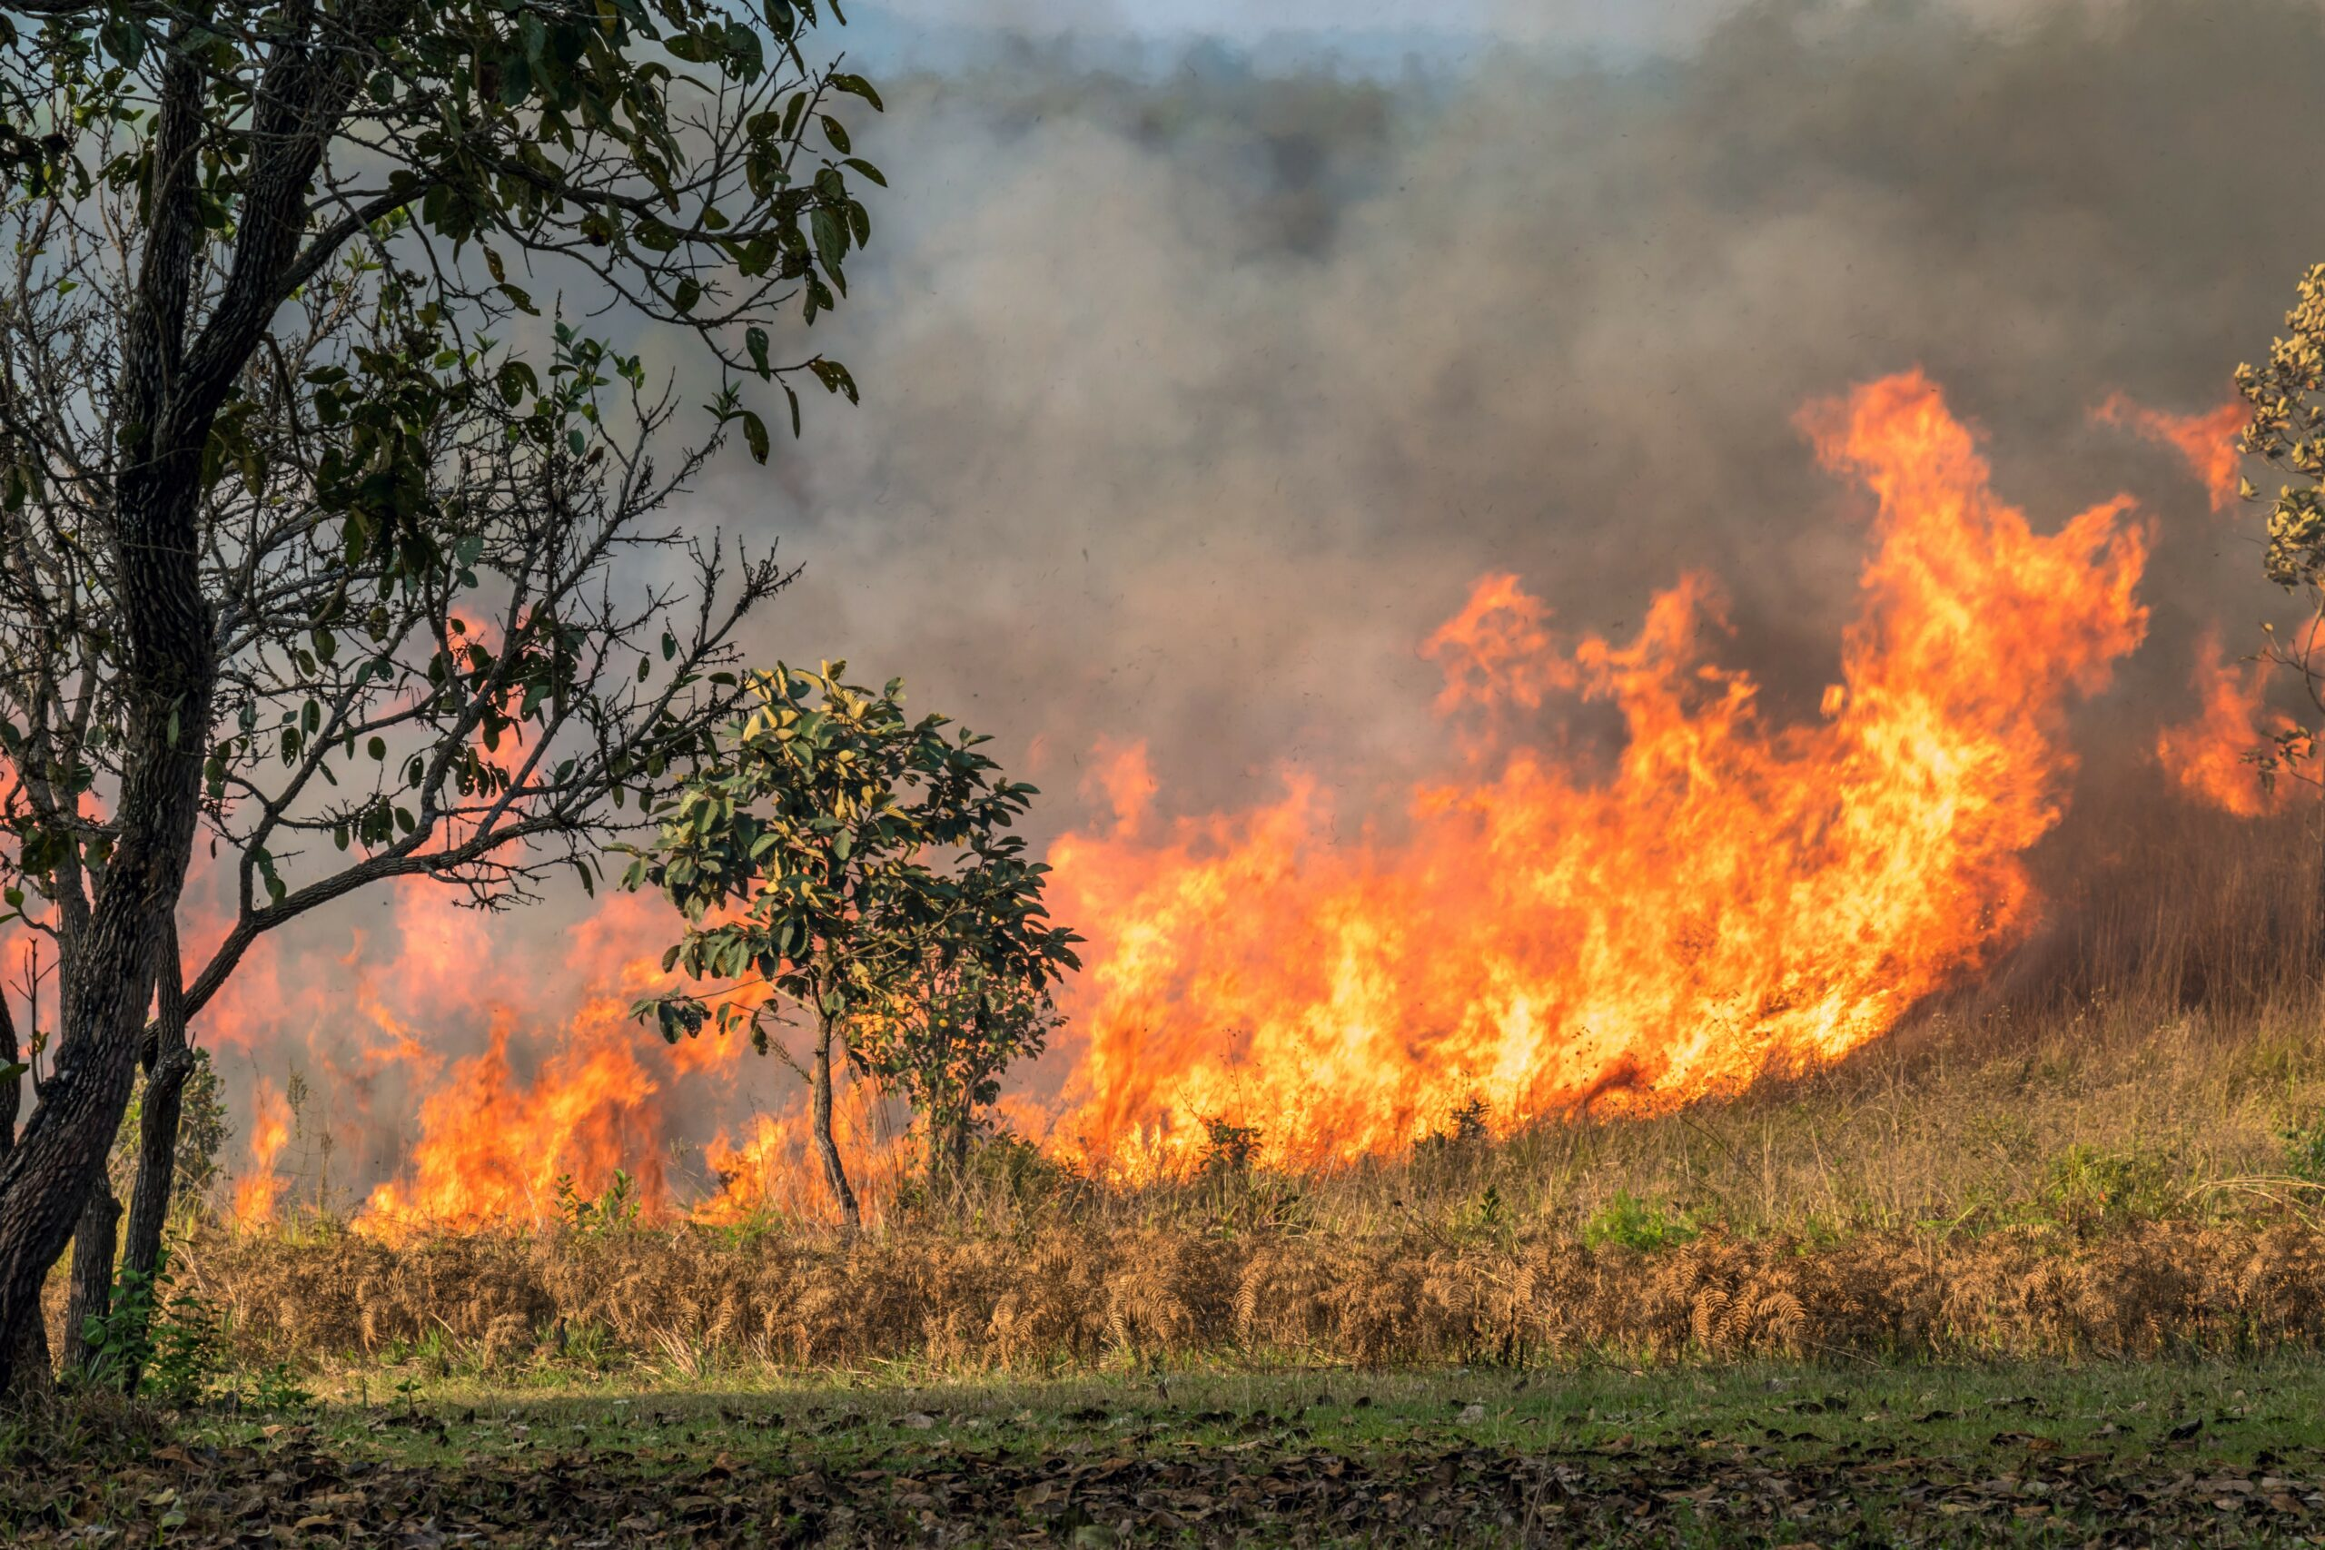
NATURAL SOURCES
Natural Sources of Air pollution are :
Volcanic eruptions: Volcanic eruptions can release large amounts of sulfur dioxide, ash, and other pollutants into the atmosphere.
Wildfires: Wildfires can release particulate matter, carbon monoxide, and volatile organic compounds into the air.
Dust storms: Strong winds can pick up large amounts of dust and sand, reducing visibility and causing respiratory problems.
Natural gas emissions: Natural gas can seep from the ground, releasing methane and other pollutants into the atmosphere.

Slide 6
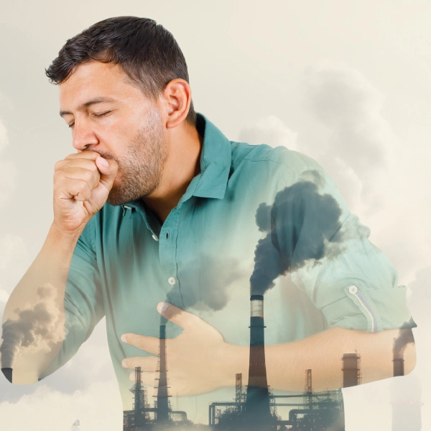

IMPACT OF AIR POLLUTION
On Human Health:
Respiratory problems: Air pollution can exacerbate conditions like asthma, chronic obstructive pulmonary disease (COPD), and other breathing problems.
Cardiovascular disease: Exposure to air pollution can increase the risk of heart attacks, strokes, and other cardiovascular problems.
Cancer: Some air pollutants have been linked to an increased risk of lung cancer and other types of cancer.
Environmental Health:
Acid rain: Air pollution can lead to acid rain, which can harm aquatic life and ecosystems.
Eutrophication: Air pollution can contribute to eutrophication, which can harm aquatic life and ecosystems.
Crop damage: Air pollution can damage crops, reducing yields and affecting food security.

Slide 7
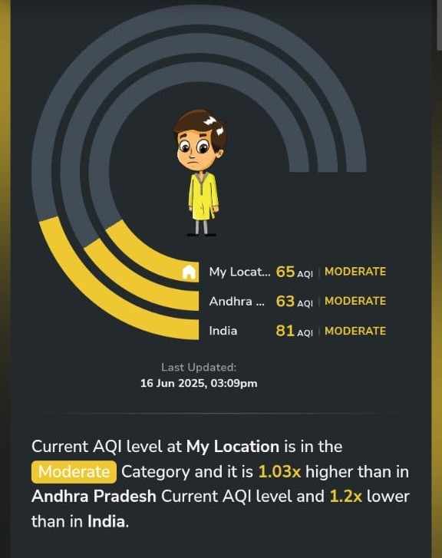
CONTROL MEASURES
Individual Actions:
Use public transportation or carpool: Reduce vehicle emissions
Recycle and reduce waste: Minimize waste disposal emissions
Plant trees and greenery: Absorb pollutants and produce oxygen.
Community and Policy Measures:
Create green spaces: Develop parks and green spaces to absorb pollutants and improve air quality
Implement air quality monitoring systems: Track Air Quality Indexes and alert the public to poor air quality
Develop and enforce air quality policies: Create and enforce policies to reduce air pollution and protect public health

Slide 8
CONCLUSION
Air pollution is a significant environmental and public health issue that requires immediate attention and collective action. By understanding the causes, effects, and control measures of air pollution, we can work together to:-
Reduce emissions: Implement policies and technologies to minimize emissions from industrial and vehicular sources.
Promote sustainable development: Encourage sustainable practices and technologies that minimize environmental impact.
By taking a comprehensive and collaborative approach, we can mitigate the impacts of air pollution and create a healthier, more sustainable environment for future generations.

Slide 9
THANK YOU

